Slide 1
What do you see? Activity
Teacher Instructions:
Show students “What do you see?” pictures and have them write what they see before their trip
to the Augusta Canal.
Pictures should be shown on computers or smart boards.
Then after your field trip, show the pictures again and have students write what they see.
Encourage students to write about what is happening in the picture as well as
descriptions and names of the parts of the picture. Hopefully the answers will be very different.
This will be a good means of assessment and a good writing exercise.
Student Instructions:
Write four paragraphs, one for each number describing what you see.
1-Two pictures
2-Two pictures
3-One picture
4-One picture
Grade 7
Anticipation Writing Activity
Assessment Writing Activity

Slide 2
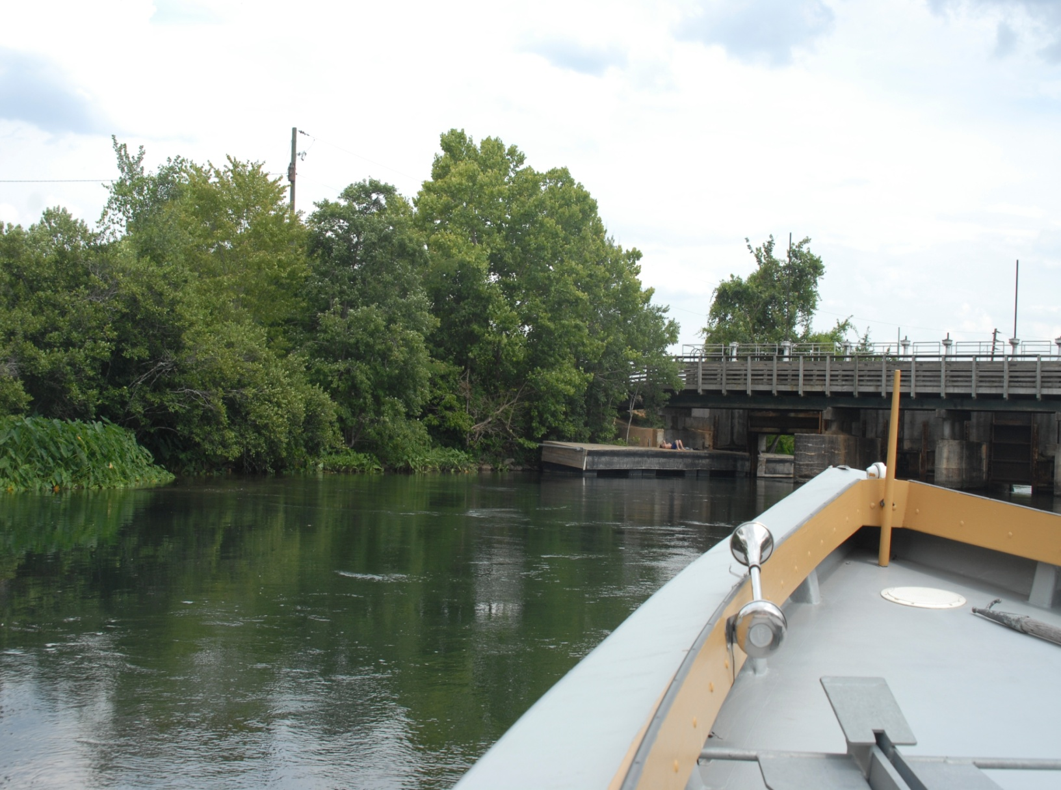
What do you see?
1

Slide 3
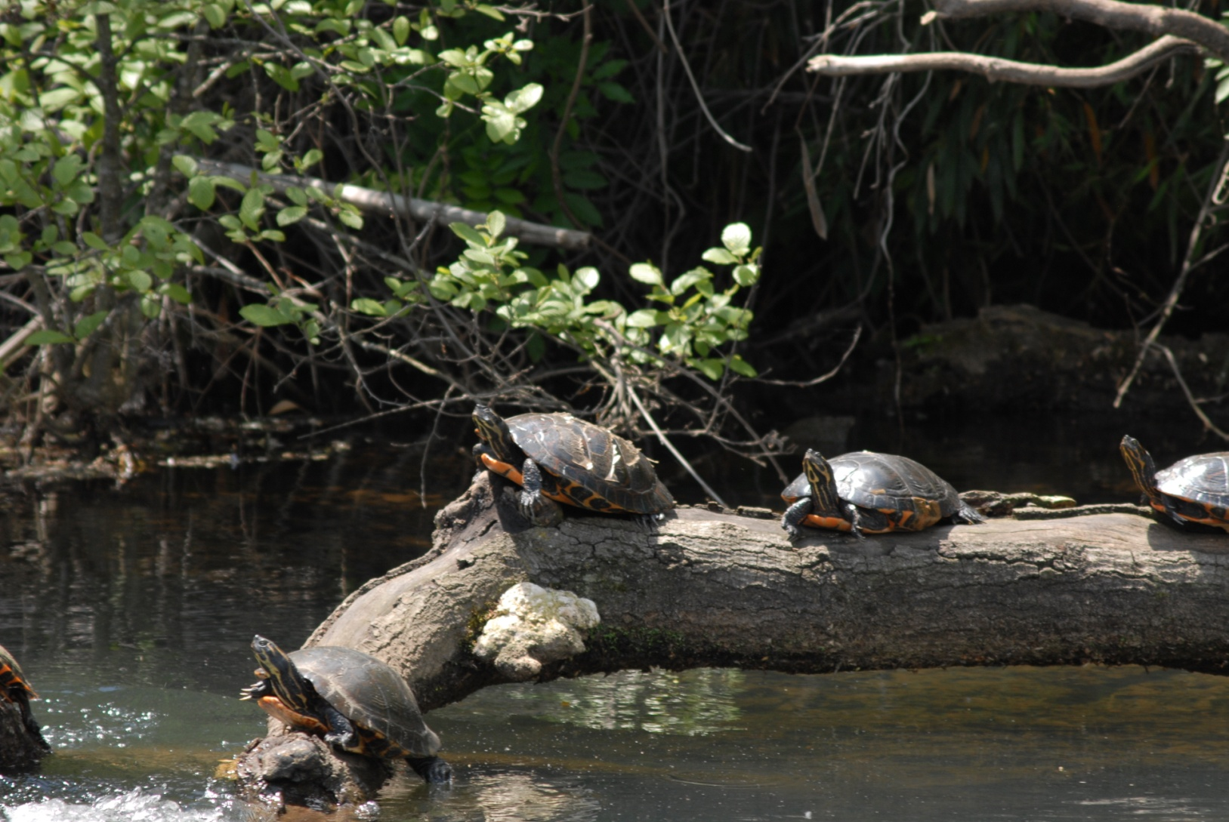
What do you see?
2
2

Slide 4
What do you see?
3

Slide 5
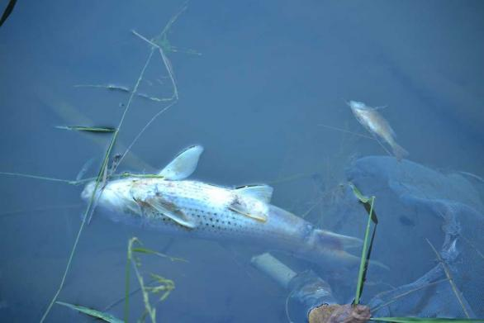
What do you see?
4

